Slide 1

Distributed File Synchronization System
A Linux-based Dropbox-like Sync Tool
Sanskar Bajimaya and Amir Karki
Linux

Slide 2

Introduction
Problem Statement:
Need for a lightweight, self-hosted file sync system.
Challenges: Real-time sync, conflict resolution, security.
Goal:
Build a server-client system to sync files over TCP/IP.

Slide 3

Introduction
Key features:
File monitoring
Authentication
Conflict resolution
Version control.

Slide 4
Existing Tools and Research
Tool | Approach | Relevance
Dropbox | Delta encoding | Commercial benchmark
rsync | Chunk-based sync | Optimization inspiration
LBFS Paper | Low-bandwidth sync | Research basis

Slide 5
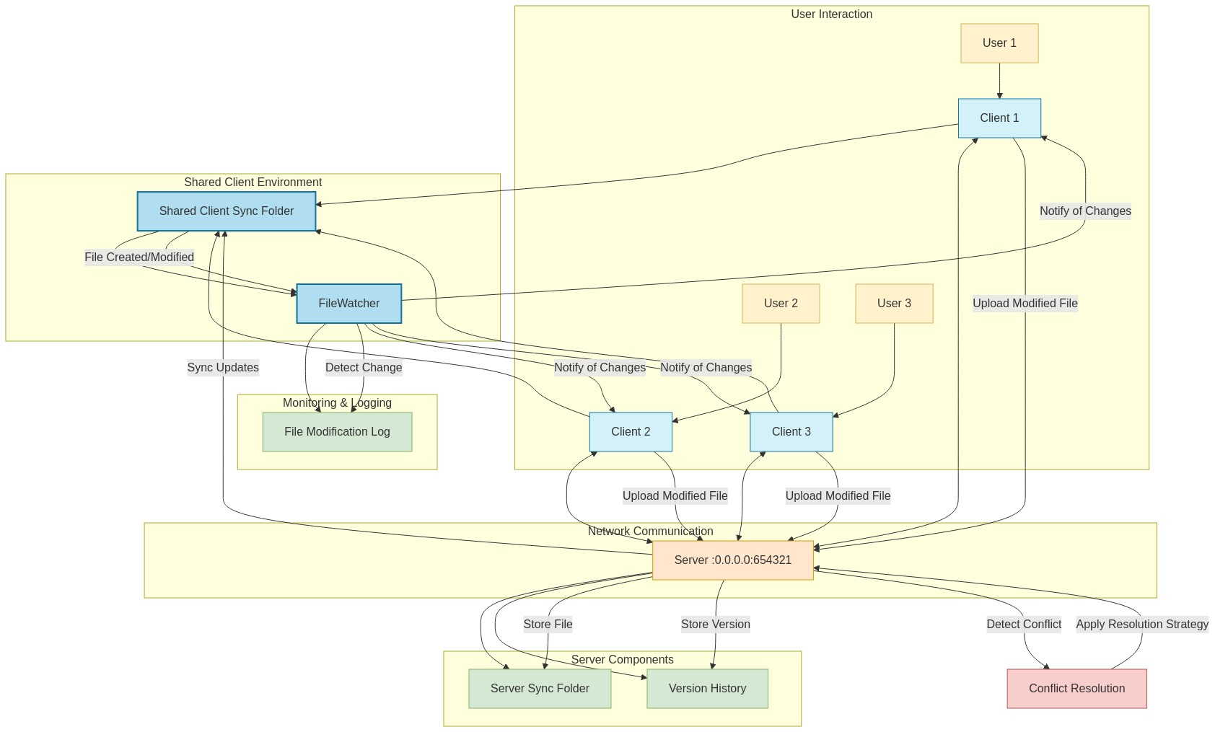
System Architecture
Components:
Clients (File Monitor, Network Handler)
Server (Central Repository, Authentication Module)
Protocol:
Custom TCP messages (UPLOAD, DOWNLOAD)

Slide 6
Implementation Phases
Phase 1
Basic TCP Communication (Python socket).
Phase 2
File Monitoring (watchdog/inotify).
Phase 3
File Transfer Protocol (Upload/Download).
Phase 4
Security (Login/Permissions).
Phase 5
Conflict Resolution (Timestamps).

Slide 7
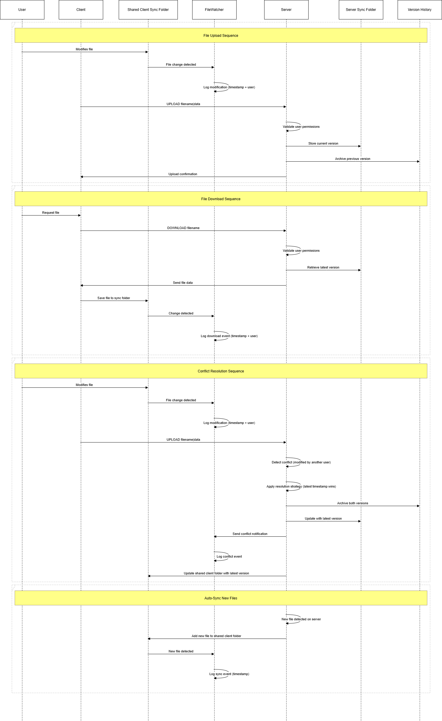
Case Diagram

Slide 8
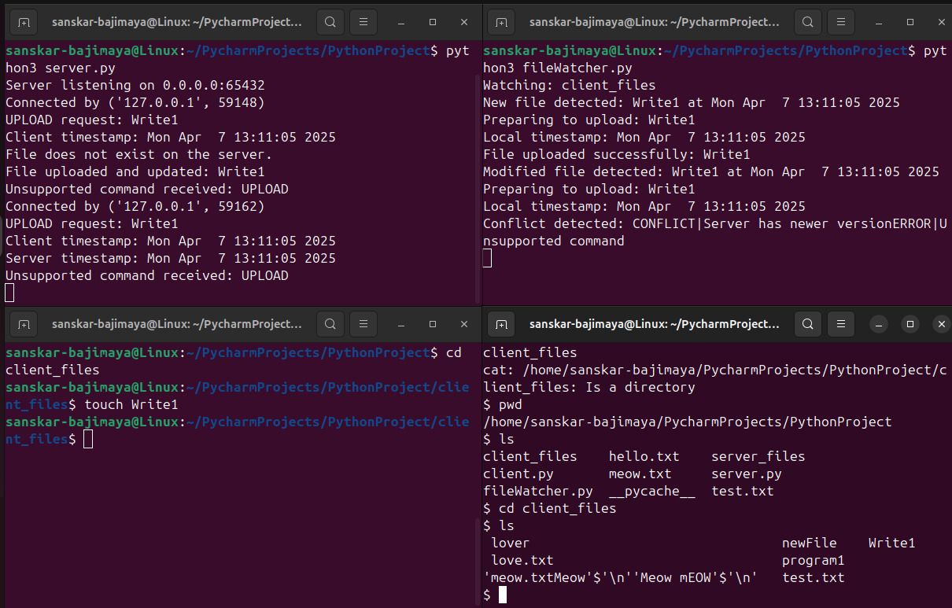
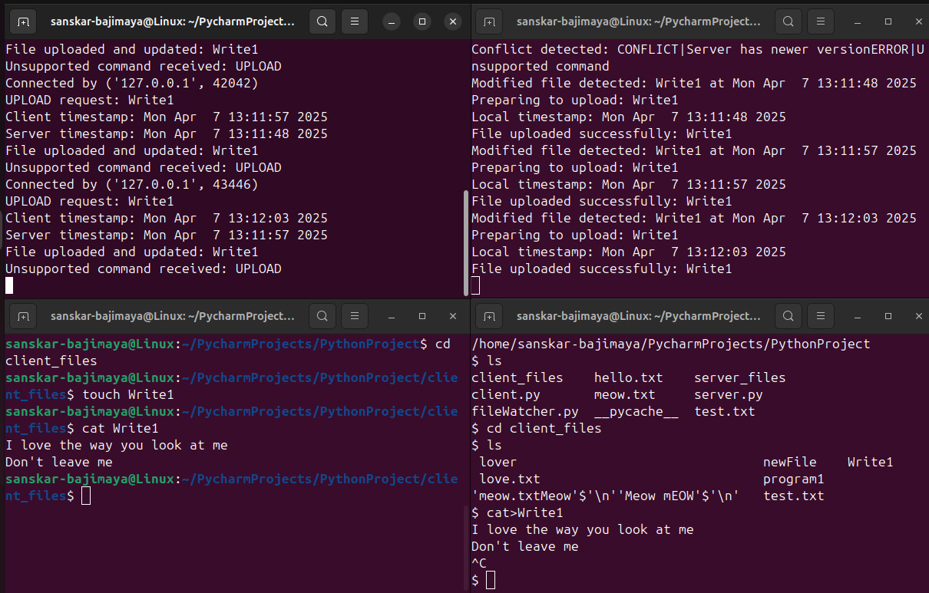
Programs Demo

Slide 9
Summary
Real Time Sync:: Time stamps guarantee and version control.
1
Conflict Resolution: "last-modified wins" strategy, backing up all version in server files.
2
Security: File permissions (chmod 770) and group-based access.
3
Automation: The watchdog library enabled seamless monitoring and synchronization of file.
4

Slide 10
Limitation and Future work
Delta Sync Optimization: Sending just modified portions (based on rsync). This affects for large files as the sync time can be reduced by 50–70%
End to End encryption: Before uploading, encrypt files client-side using security like AES-256.
GUI implementation: Plan of Implementation is using PyQt/Tkinter which is a desktop graphical user interface that displays conflicts, version history, and sync status.

Slide 11

Thank you!

